Slide 1
18ECC203J – Module 1 Intel 8086 – Architecture, Signals and Features S – 1
Prepared by,
Dr. R. Manohari
Dr.T.Rajalakshmi

Slide 2
S – 1 Introduction: History of computers, Block diagram of a microcomputer & Intel 80x86 evolutions

Slide 3
Definition of Computer
A computer is an electronic machine that accepts information (Data), processes it according to specific instructions and provides the results as new information.
Inputs, outputs, processes and stores information
Physical: Keyboard, monitor, etc. – are these necessary components?

Slide 4
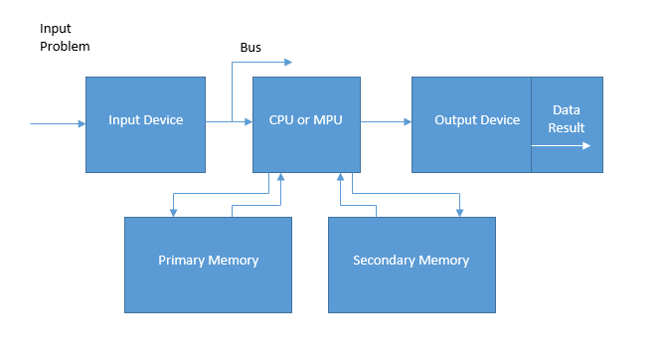
Block Diagram of Microcomputer
Block diagram of a microcomputer consist of
Input Device for receiving input instruction.
CPU or MPU for processing the instruction.
Primary and Secondary Memory to store the information.
Output Device for giving the output.
Data Result

Slide 5
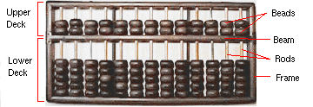
History of Computers - Long, Long Ago
Abacus - 3000 BC
beads on rods to count and calculate
still widely used in Asia!

Slide 6
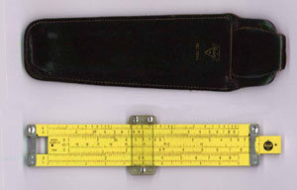
History of Computers - Way Back When
Slide Rule
Slide Rule 1630
based on Napier’s rules for logarithms
used until 1970s

Slide 7
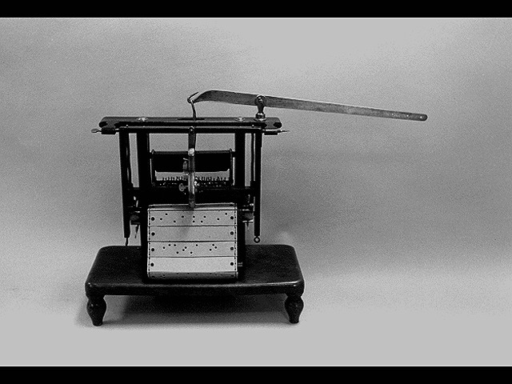
History of Computers - 19th Century
Jacquard Loom - 1801
first stored program - metal cards
first computer manufacturing
still in use today!

Slide 8
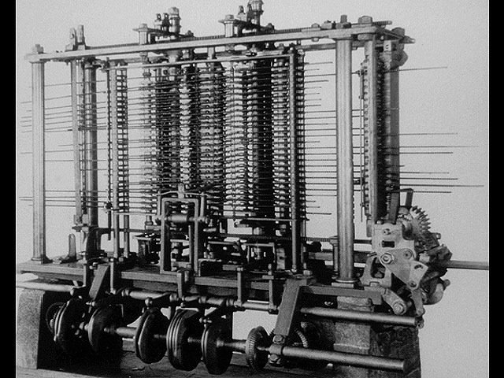
Charles Babbage - 1792-1871
Difference Engine c.1822
huge calculator, never finished
Analytical Engine 1833
could store numbers
calculating “mill” used punched metal cards for instructions
powered by steam!
accurate to six decimal places
Analytical Engine

Slide 9

Vacuum Tubes - 1941 - 1956
First Generation Electronic Computers used Vacuum Tubes
Vacuum tubes are glass tubes with circuits inside.
Vacuum tubes have no air inside of them, which protects the circuitry.

Slide 10
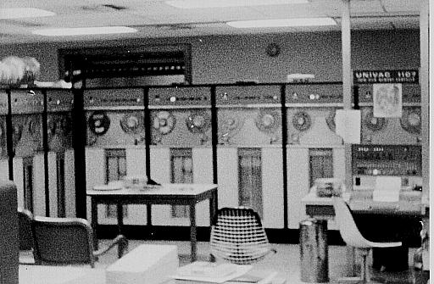
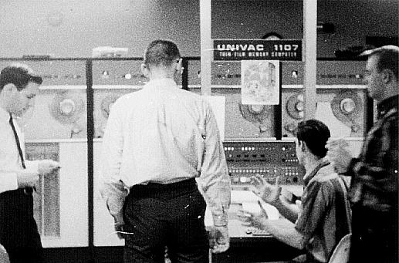
UNIVAC - 1951
first fully electronic digital computer built in the U.S.
Created at the University of Pennsylvania
ENIAC weighed 30 tons
contained 18,000 vacuum tubes
Cost a paltry $487,000

Slide 11
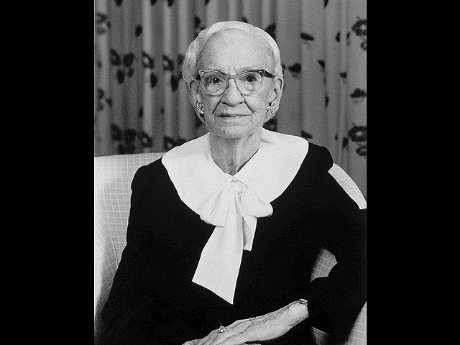
Grace Hopper
Programmed UNIVAC
Recipient of Computer Science’s first “Man of the Year Award”

Slide 12
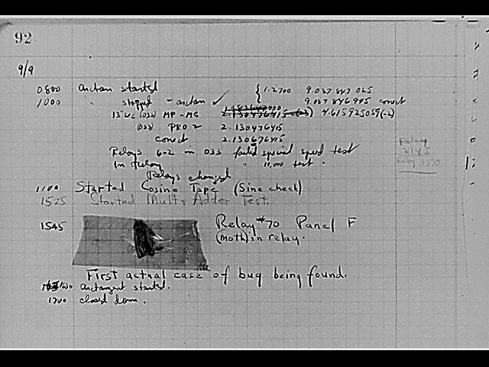
First Computer Bug - 1945
Relay switches part of computers
Grace Hopper found a moth stuck in a relay responsible for a malfunction
Called it “debugging” a computer

Slide 13
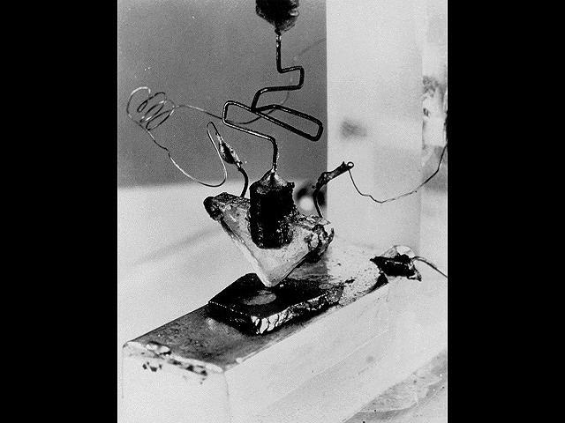
First Transistor
Uses Silicon
developed in 1948
won a Nobel prize
on-off switch
Second Generation Computers used Transistors, starting in 1956

Slide 14
Second Generation – 1956-1963
1956 – Computers began to incorporate Transistors
Replaced vacuum tubes with Transistors

Slide 15
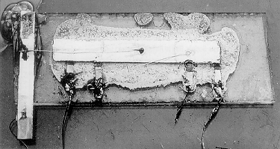
Integrated Circuits
Third Generation Computers used Integrated Circuits (chips).
Integrated Circuits are transistors, resistors, and capacitors integrated together into a single “chip”

Slide 16
Operating System
Software – Instructions for Computer
Operating system is set of instructions loaded each time a computer is started
Program is instructions loaded when needed

Slide 17
Third Generation – 1964-1971
1964-1971
Integrated Circuit
Operating System
Getting smaller, cheaper

Slide 18
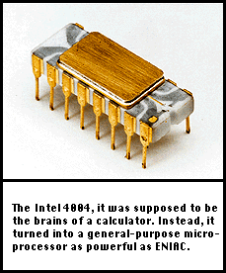
The First Microprocessor – 1971
Intel 4004 Microprocessor
The 4004 had 2,250 transistors
four-bit chunks (four 1’s or 0’s)
108Khz
Called “Microchip”

Slide 19
What is a Microchip?
Very Large Scale Integrated Circuit (VLSIC)
Transistors, resistors, and capacitors
4004 had 2,250 transistors
Pentium IV has 42 MILLION transistors
Each transistor 0.13 microns (10⁻⁶ meters)

Slide 20
4th Generation – 1971-present
MICROCHIPS!
Getting smaller and smaller, but we are still using microchip technology

Slide 21
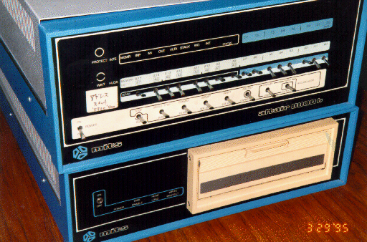
Birth of Personal Computers - 1975
MITS Altair
256 byte memory (not Kilobytes or Megabytes)
2 MHz Intel 8080 chips
Just a box with flashing lights
cost $395 kit, $495 assembled.

Slide 22
Generations of Electronic Computers

Slide 23
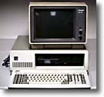
IBM PC - 1981
IBM-Intel-Microsoft joint venture
First wide-selling personal computer used in business
8088 Microchip - 29,000 transistors
4.77 Mhz processing speed
256 K RAM (Random Access Memory) standard
One or two floppy disk drives

Slide 24
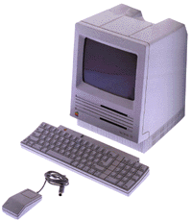
Apple Computers
Founded 1977
Apple II released 1977
widely used in schools
Macintosh (left)
released in 1984, Motorola 68000 Microchip processor
first commercial computer with graphical user interface (GUI) and pointing device (mouse)

Slide 25
Computers Progress

Slide 26
1990s: Pentiums and Power Macs
Early 1990s began penetration of computers into every niche: every desk, most homes, etc.
Faster, less expensive computers paved way for this
Windows 95 was first decent GUI for “PCs”
Macs became more PC compatible - easy file transfers
Prices have plummeted
$2000 for entry level to $500
$6000 for top of line to $1500

Slide 27
Microprocessor
Fifth Generation Pentium
Fourth Generation
During 1980s
Low power version of HMOS technology (HCMOS)
32 bit processors
Physical memory space 2²⁴ bytes = 16 Mb
Virtual memory space 2⁴⁰ bytes = 1 Tb
Floating point hardware
Supports increased number of addressing modes
Intel 80386
Third Generation
During 1978
HMOS technology ⇒ Faster speed, Higher packing density
16 bit processors ⇒ 40/ 48/ 64 pins
Easier to program
Dynamically relatable programs
Processor has multiply/ divide arithmetic hardware
More powerful interrupt handling capabilities
Flexible I/O port addressing
Intel 8086 (16 bit processor)
Second Generation
During 1973
NMOS technology ⇒ Faster speed, Higher density, Compatible with TTL
4 / 8/ 16 bit processors ⇒ 40 pins
Ability to address large memory spaces and I/O ports
Greater number of levels of subroutine nesting
Better interrupt handling capabilities
Intel 8085 (8 bit processor)
First Generation
Between 1971 – 1973
PMOS technology, non compatible with TTL
4 bit processors ⇒ 16 pins
8 and 16 bit processors ⇒ 40 pins
Due to limitations of pins, signals are multiplexed

Slide 28
Microprocessor Definition
Microprocessor is a programmable device that takes in numbers, performs on them arithmetic or logical operations according to the program stored in memory and then produces other numbers as a result.

Slide 29
Basic Concepts of Microprocessors
Differences between:
Microcomputer –a computer with a microprocessor as its CPU. Includes memory, I/O etc.
Microprocessor –silicon chip which includes ALU, register circuits, instruction decoder circuits & control circuits
Microcontroller –silicon chip which includes microprocessor, memory & I/O in a single package

Slide 30
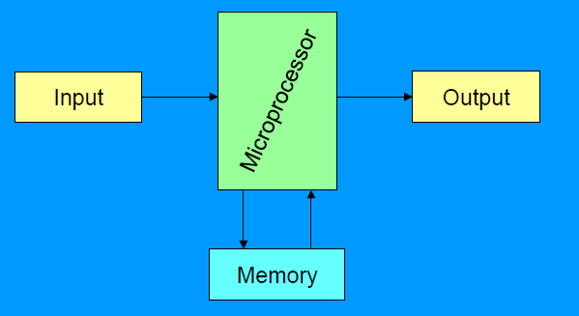
A Microprocessor based system (fig 1)

Slide 31
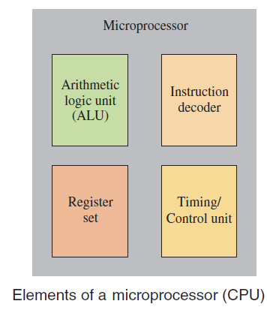
Inside the Microprocessor

Slide 32
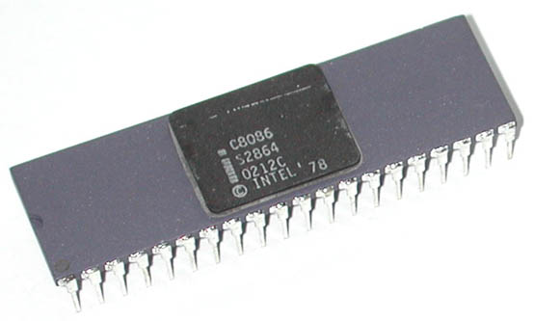
INTEL 8086
INTEL 8086 is the first 16-bit processor released by INTEL in the year 1978
Third Generation Microprocessors
Designed using HMOS technology & now it is manufactured using HMOS III technology & contains approximately 29,000 transistors.
It is available as 40-pin Dual in-line Package (DIP).

Slide 33
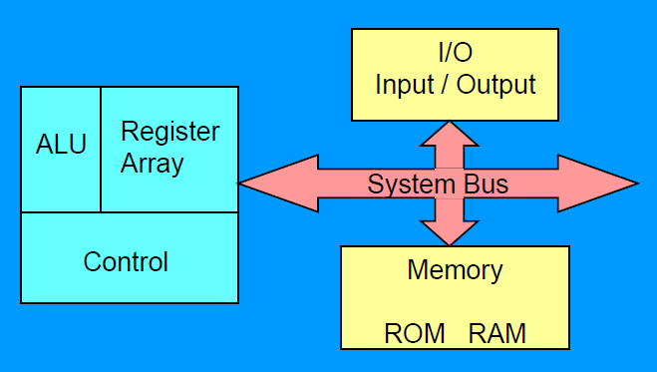
Organization of a microprocessor-based system
Let’s expand the fig 1 a bit

Slide 34
INTEL 8086
It is available in four versions:
8086 (5 MHz)
8086-2 (8 MHz)
8086-4 (4 MHz)
8086-1 (10 MHz)

Slide 35
Thank You

